Slide 1
Grouping and Summarizing Data
Robert Benirschke
July 23, 2023

Slide 2
September 26, 2021 | Session | Instructor
8:30 am - 8:45 am | Course Introduction | Robert Benirschke
8:45 am – 9:30 am | Intro to R and Reproducible Reporting | Amrom Obstfeld
9:45 am - 10:30 am | Coding Basics and Importing Data | Amrom Obstfeld
10:45 am – 11:30 am | Data Transformation | Robert Benirschke
LUNCH
12:30 pm - 1:30 pm | Grouping and Summarizing Data | Robert Benirschke
1:45 pm – 2:45 pm | Data Visualizations | Patrick Mathias
3:00 pm - 3:30 pm | Advanced Reporting | Patrick Mathias

Slide 3
Goals
Learn dplyr tools for grouping and summarizing data in R
Objectives
Calculate a summary statistic for a variable using the summarize() function
Creates groupings of data using the group_by() function
Combine group_by() and summarize() functions to calculate summary statistics for groups of data

Slide 4
Typical Data Science Pipeline
From R for Data Science (https://r4ds.had.co.nz/introduction.html)

Slide 5
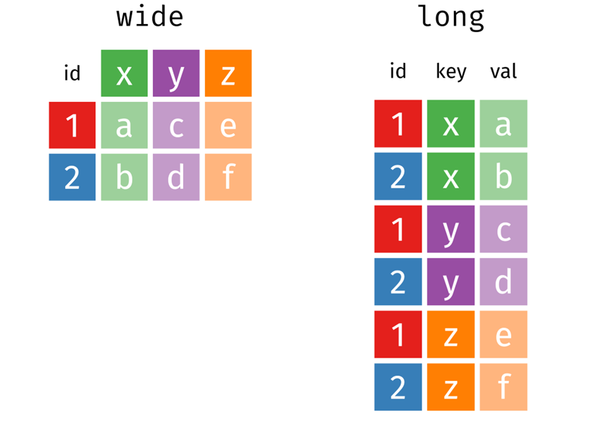
Long vs. Wide Format Data
Introduction to the Tidyverse: How to be a Tidy Data Scientist, Olivier Giminez, November 2020 (https://oliviergimenez.github.io/intro_tidyverse/#50)

Slide 6
Summarize()

Slide 7
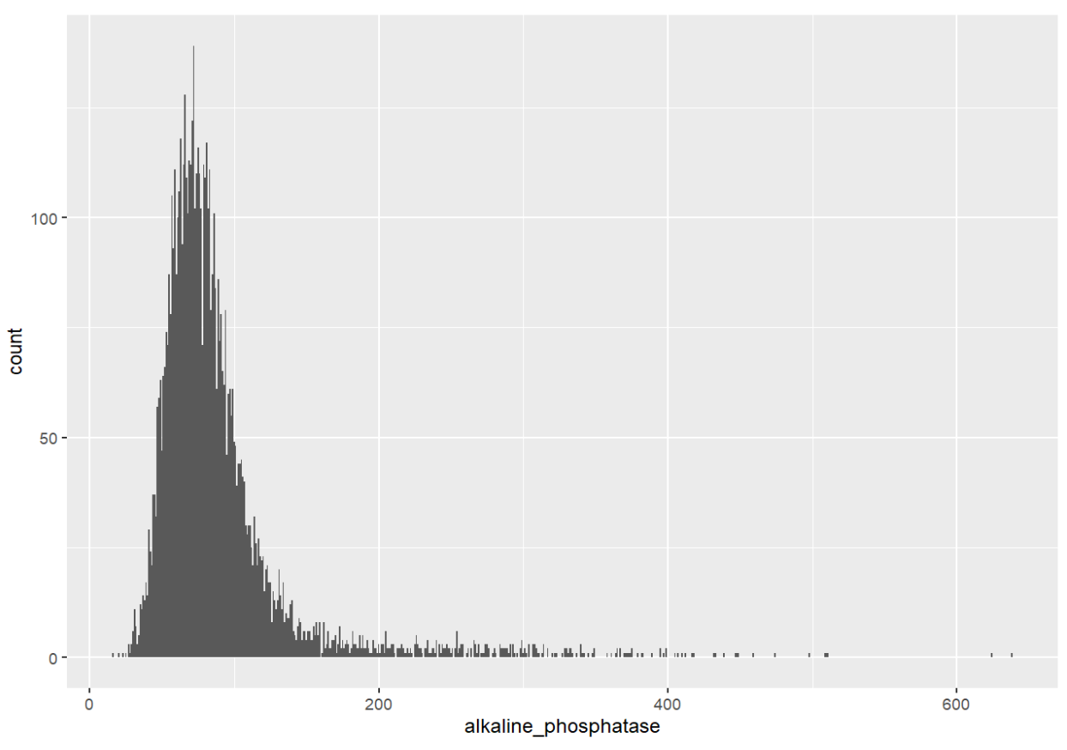
Q: What is the distribution of Alkaline Phosphatase results?

Slide 8
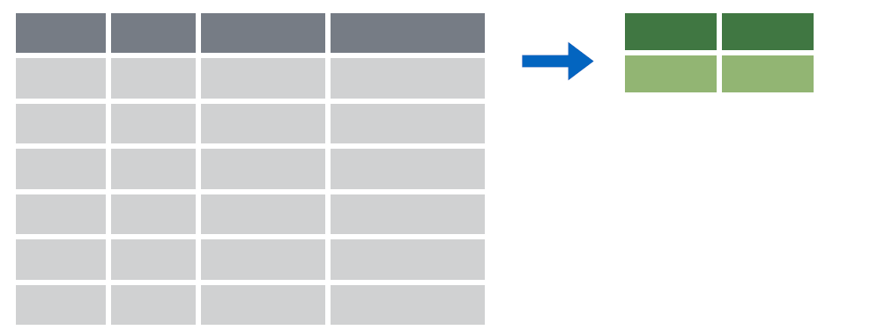

summarize()
Make summaries of your data

Slide 9
summarize()
Make summaries of your data
biochem %>%
summarize(new_variable = calculation)
name for new variable
Value or function

Slide 10
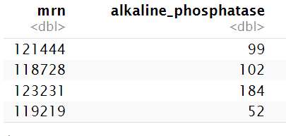
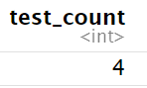
summarize()
function that returns number of observations
Make summaries of your data
biochem %>%
select(mrn, alkaline_phosphatase) %>%
head(4) %>%
summarize(test_count = n())

Slide 11
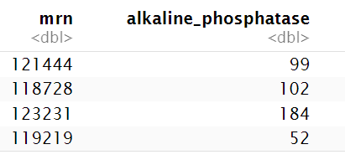
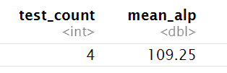
summarize()
function that returns number of distinct values
Make summaries of your data
biochem %>%
select(mrn, alkaline_phosphatase) %>%
head(4) %>%
summarize(test_count = n(),
mean_alp = mean(alkaline_phosphatase))

Slide 12
Your Turn #1
- Open “05 – Group by and Summarize.Rmd”
- Run the setup chunk
- Fill-in gaps to calculate:
a) Median Alkaline Phosphatase concentration
b) Mean Calcium concentration
c ) Interquartile range of Alkaline Phosphatase
d ) Standard deviation of Calcium

Slide 13
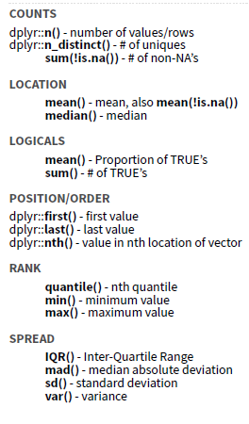

Slide 14
summarize() examples
Minimum and maximum values
Calculate the center 95th percentile range
Calculate the variance
Calculate the coefficient of variation

Slide 15

Your Turn #2
Consider:
How would you calculate the median Alkaline Phosphatase concentration in Men vs. Women?

Slide 16
group_by()

Slide 17
group_by()

Slide 18
group_by()
Grouping observations based on a specific variable’s values
biochem %>%
group_by(variable)
name of variable to group by

Slide 19
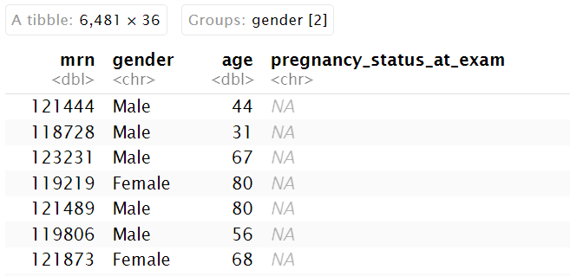
group_by()
Group observations by gender
Biochem %>%
group_by(gender)

Slide 20
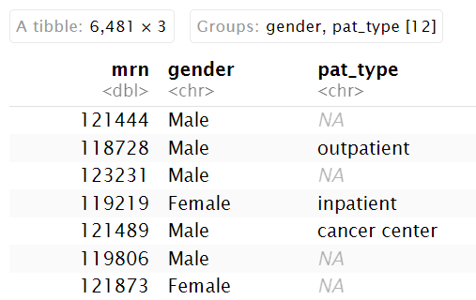
group_by()
Group observations by `gender` and `pat_type`
covid_testing %>%
select(mrn, gender, pat_type) %>%
group_by(gender, pat_type)

Slide 21
group_by() %>% summarize()

Slide 22
group_by()
%>%
summarize()
Make summaries of your data by group

Slide 23
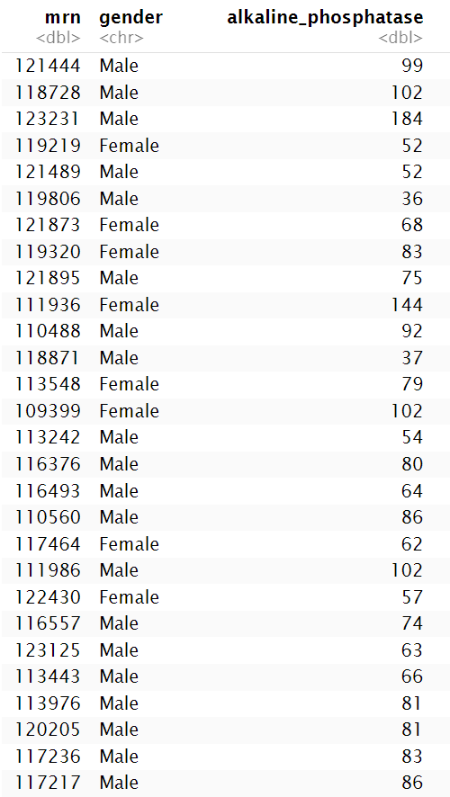
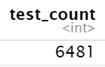
group_by() %>% summarize()
Make summaries of your data
biochem %>%
summarize(test_count = n())

Slide 24
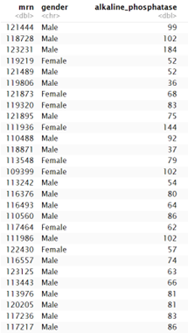
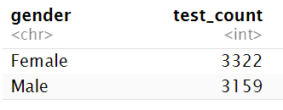
group_by() %>% summarize()
Make summaries of your data
biochem %>%
group_by(gender) %>%
summarize(test_count = n())

Slide 25
Your Turn #3
Calculate:
a) The median Alkaline Phosphatase concentration in Men and Women
b) (*Extra*) The median Alkaline Phosphatase concentration in Men and Women over 51

Slide 26
Recap
Summarize() is a function that enables us to calculate summaries of variables (columns).
Common summary activities include counting observations using n(), counting unique observations using n_distinct(), and calculating means using mean().
Group_by() is a function that enables us to create subsets of data by a variable. Data can also be grouped by multiple variables.
Combining the group_by() and summarize() functions is a powerful way to look at summarizations across groups.

Slide 27
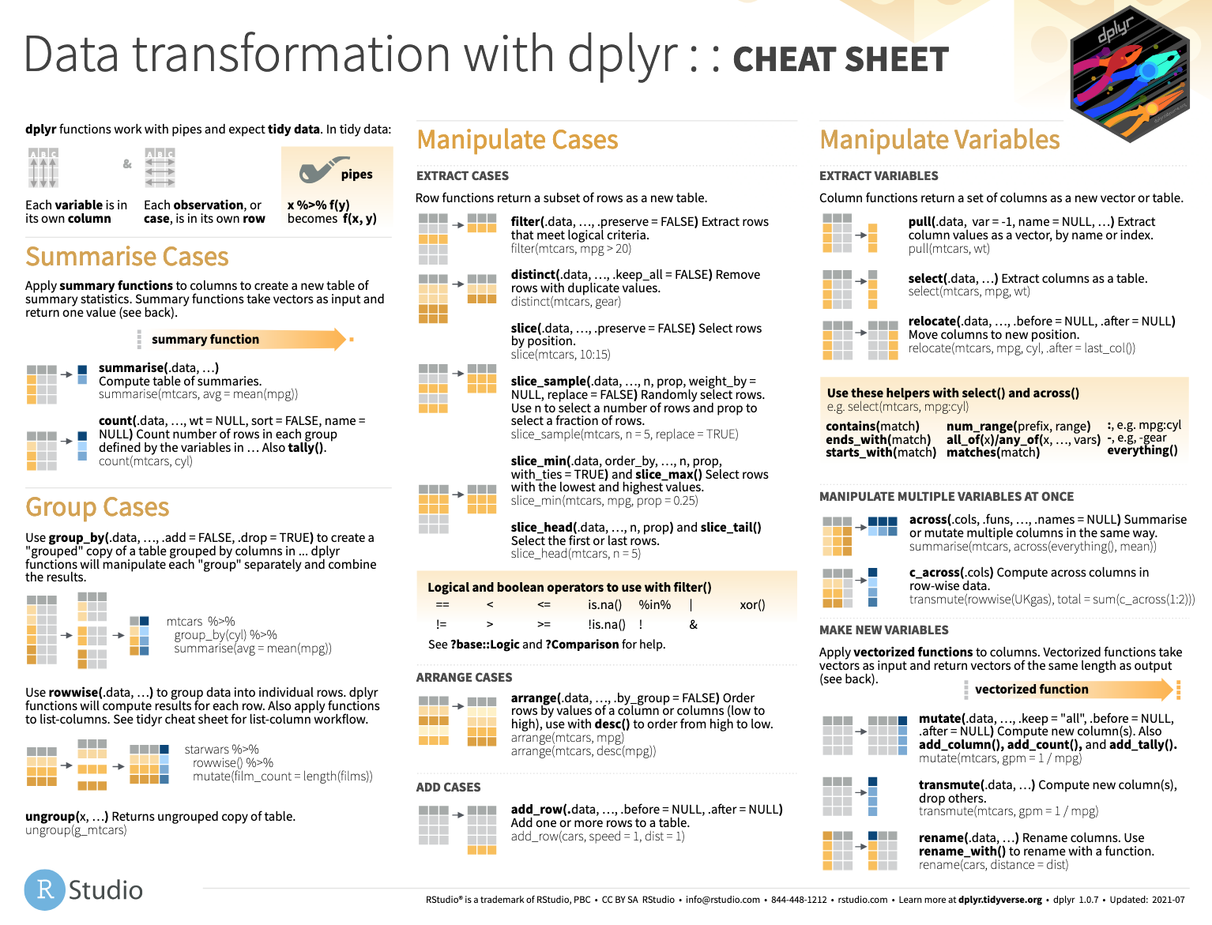

Slide 28
What else?

Slide 29
Statistical Tests

Slide 30
Basic Statisical Tests
T-test
t.test(x, y, paired = FALSE)
Wilkoxon Rank Sum Test
wilcox.test(x, y, paired = FALSE)
Chi Squared Test
chisq.test(df)
Where df is a dataframe that contains categorical count information
The R help documentation provides details for further customization

Slide 31
Is the difference between Men and Women Over 51 Significant?
#filter males over 51
biochem_male <- biochem %>%
filter(gender == "Male" & age >51)
#filter females over 51
biochem_female <- biochem %>%
filter(gender == "Female" & age > 51)
#create variables for alkaline phosphatase
alp_male <- biochem_male$alkaline_phosphatase
alp_female <- biochem_female$alkaline_phosphatase
#perform unpaired wilkoxon rank sum test
wilcox.test(alp_male, alp_female, paired=FALSE)

Slide 32
Results
Wilcoxon rank sum test with continuity correction
data: alp_male and alp_female
W = 767533, p-value < 2.2e-16
alternative hypothesis: true location shift is not equal to 0

Slide 33
Regression Modeling

Slide 34
Linear Regression
lm.fit <- lm(y ~ x, data)
lm.fit <- lm(y ~ x1 + x2 + … + xn, data)
Function for linear regression is “lm”

Slide 35
Example
lm.model <-
lm(blood_urea_nitrogen ~
creatinine + aspartate_aminotransferase, biochem)
summary(lm.model)

Slide 36
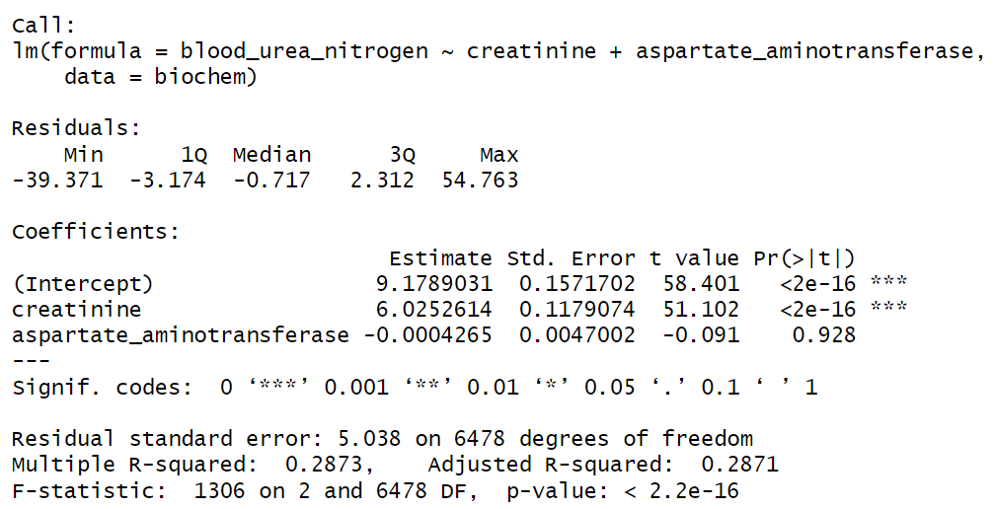
Results

Slide 37
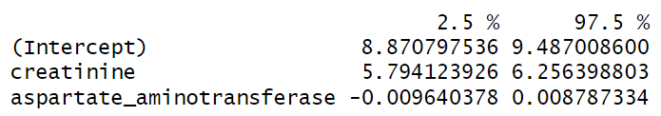
Extracting Information From Model
lm.model$coefficients
BUN = 6.0253*creatinine + 0.0004*AST + 9.1789
confint(lm.model)

Slide 38
Goals
Learn dplyr tools for grouping and summarizing data in R
Objectives
Calculate a summary statistic for a variable using the summarize() function
Creates groupings of data using the group_by() function
Combine group_by() and summarize() functions to calculate summary statistics for groups of data

